Slide 1
Project Crispy Crawl
A video game by Steven, George, Wesley, and Jeremy

Slide 2
Development and design
George – Design, additional programing, minor help with music and sound effects.
Steven – Design, primary programing, engine design and programing.
Wesley – Design, Music design, sound effects.
Jeremy – Design, artwork and sprite work, additional programing.

Slide 3
Game features
Over world map
Weapon class system
Legend of Zelda style dungeon system
Lan co-op Multiplayer
10 dungeons to explore with increasing difficulty. (More to be added if time and scope allows.)
Shop system to buy new weapons and items
Combat triangle to disallow dominant strategy

Slide 4


Technology used
Allegro

Slide 5
Over World map system
Linear progression from one stage to the next
Similar to Mario 3 – and Super Mario World map system.
Shop and dungeons selected from this map.

Slide 6
Battle system
Top down view
Easy to understand while still giving the player a challenge.
Magic, melee and ranged attacks to suit your play style.

Slide 7
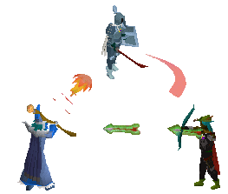
Combat triangle
Disallows dominant strategy
Magic is weak to ranged
Melee is weak to magic
Ranged is weak to melee

Slide 8
Thank you for watching!
PowerPoint designed and created by George Lininger
Additional editing of power point by : Steven, Wesley, and Jeremy.

